Slide 1
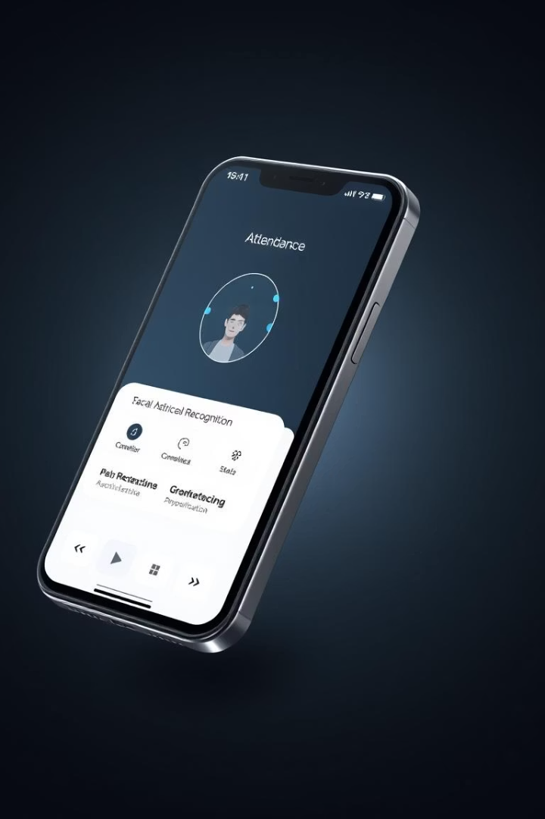
Mobile Attendance Management System
This report provides a comprehensive overview of the database design and implementation for a mobile attendance management system. It integrates facial recognition, geofencing, and real-time session management to ensure accuracy and efficiency in tracking attendance.
Presented by Group 7 for CEF440: Internet Programming and Mobile Programming, instructed by Dr. Nkemeni Valery.

Slide 2
Understanding Data Elements
A data element is a fundamental unit representing a specific piece of information, serving as a container for a single data item like a name or date. Each element has a unique purpose within the application, representing an attribute of an entity in the database.
Key aspects include data type, uniqueness, functional relevance, and importance. Data elements ensure integrity and consistency by defining types and constraints, preventing incorrect or ambiguous data storage. They are crucial for efficient data management and application functionality.
Data Type
Uniqueness
Determines the kind of values a data element can hold (e.g., integer, string, date).
Ensures each piece of information is uniquely identifiable and manageable.
Data Integrity
Application Functionality
Helps prevent incorrect or inconsistent data through defined types and constraints.
Crucial for the application to perform its tasks by representing essential information.

Slide 3

System Data Elements
The system utilizes specific data elements for each actor: students, lecturers, and administrators. These elements define the information each actor operates with, ensuring proper identification, authentication, and management within the system.
Beyond actor-specific data, the database also includes system-level data elements like primary keys for unique identification and foreign keys for table interconnections, along with additional information such as dates, timeframes, and hall names.
Actor
Key Data Elements
Uniqueness
Student
Name, Matricule, Email, Facial Data
Matricule, Email
Lecturer
Name, Lecturer ID, Email, Courses Given
Lecturer ID, Email
Admin
Full Name, Admin Code, Email, Institution
Institution, Email

Slide 4
Conceptual Design: The System Blueprint
A conceptual design is a high-level representation of a system, illustrating its fundamental components without delving into specific implementation details. It acts as a blueprint, defining the logical structure of entities, their attributes, and their interactions within the system ecosystem.
This design outlines an integrated attendance management system, combining facial recognition with geofencing for comprehensive student tracking in educational institutions. It ensures all stakeholders share a common vision and helps mitigate risks early in the planning phase.
1
Strategic Planning
2
Risk Mitigation
Provides a clear understanding of the system's scope and purpose for all stakeholders.
Identifies potential challenges and missing requirements early in the planning phase.
3
Communication
4
Technical Foundation
Facilitates effective communication between technical teams and stakeholders.
Serves as a roadmap for subsequent detailed design and technical implementation.

Slide 5
Core Entities of the System
The attendance management system is built around several core entities that interact to provide comprehensive tracking. Students are the primary subjects, linked to courses and class sessions. Courses define the academic structure, connecting to sessions and administrative oversight.
Class sessions are critical for real-time attendance capture, linking course structure with classroom infrastructure. Administrative components like Admin and Lecturer provide oversight and direct involvement in attendance verification, ensuring system governance and academic delivery.
Student
Course
Class Session
Admin
Primary subject of the attendance system, central to all tracking activities.
Represents academic curriculum structure, linking to sessions and administration.
Individual class meetings, critical for real-time attendance capture.
Provides system oversight and management capabilities, ensuring governance.
Lecturer
Teaching staff responsible for course delivery and attendance verification.

Slide 6





Data Collection and Infrastructure
The system's data collection relies on the Attendance entity, a central repository for records, and Face Data for biometric identification. These components ensure accurate and automated student identification, enhancing the reliability of attendance marking.
Infrastructure components like Classroom, System Config, and Location provide the physical and technical context for attendance tracking. They enable location-specific settings and geo-location verification, supporting multi-location institutional requirements and proper system operation.
Attendance
Face Data
Classroom
Central repository for attendance records, linking multiple entities.
Biometric identification for automated student verification.
Physical space for learning activities, providing environmental context.
System Config
Manages system-wide parameters and settings for customization.

Slide 7
Entity-Relationship Diagram Analysis
The Entity-Relationship (ER) Diagram illustrates the detailed structure and relationships between various entities in the system. Key entities include Student, Attendance Record, Course, Administrator, Lecturer, Class Session, Location, System Configuration, and Face Data.
Each entity has a primary key for unique identification and specific attributes. Relationships, both primary (one-to-many) and secondary (many-to-one, one-to-one), define how these entities interact, ensuring comprehensive data tracking and system functionality.
Student Entity
1
Core user, identified by matriculation number, linked to attendance and courses.
2
Attendance Record
Captures individual attendance instances, linking students to sessions and courses.
Course Entity
3
Represents academic subjects, linked to lecturers, students, and sessions.
4
Administrator Entity
Manages system configuration, user accounts, and overall maintenance.
Lecturer Entity
5
Faculty members teaching courses and managing attendance.
6
Class Session Entity
Individual class meetings with scheduling and location details.
Location Entity
7
Defines valid venues for sessions, with GPS coordinates and geofence parameters.
8
Face Data Entity
Stores biometric information for student identification and verification.

Slide 8



Database Implementation with Supabase
The PostgreSQL database schema is designed for comprehensive attendance tracking, with tables for users, locations, face encodings, and attendance records. Supabase serves as the hosting platform, providing PostgreSQL services with built-in authentication, real-time subscriptions, and API generation.
Data security includes encryption at rest and in transit for sensitive information, with secure hashing for credentials and SSL/TLS for communications. Privacy measures involve data anonymization, retention policies, and compliance with data protection regulations, ensuring data minimization and user rights.
Schema Design
PostgreSQL schema with core entities for users, locations, and attendance records.
Supabase Integration
Leverages Supabase for hosting, authentication, real-time features, and row-level security.
Data Security
Encryption, secure hashing, SSL/TLS, and data anonymization for privacy.

Slide 9
Backend Implementation with FastAPI
The FastAPI backend employs a modular architecture, separating concerns for authentication, geofencing, facial recognition, and attendance management. It uses RESTful principles and asynchronous programming for efficient handling of concurrent requests.
Authentication is JWT token-based with role-based access control. Geofencing validates locations using GPS coordinates and algorithms, while facial recognition processes images for identity verification. Core attendance services manage check-in/out, calculations, and notifications, ensuring real-time updates and robust exception handling.
API Architecture
Modular design with routers, middleware, and dependency injection for efficient processing.
Authentication
JWT token-based authentication with role-based access control and multi-factor options.
Geofencing
Validates employee locations against predefined boundaries using GPS coordinates.
Facial Recognition
Processes images for identity verification, with optimization for various conditions.
Attendance Services
Handles check-in/out, calculations, and notifications with real-time updates.

Slide 10








Optimization, Security, and Monitoring
Performance optimization includes strategic indexing, query caching, and batch processing. Scalability is achieved through horizontal scaling, load balancing, and database partitioning, supporting containerization and auto-scaling.
Security measures encompass data protection (encryption, masking), API security (rate limiting, input validation), and secure token management. Comprehensive monitoring tracks performance, API response times, and health metrics, with regular maintenance procedures for database optimization, backups, and updates.
Performance Optimization
Scalability
Indexing, query caching, and batch processing for efficiency.
Horizontal scaling, load balancing, and database partitioning for growth.
Monitoring & Maintenance
Security Implementation
Real-time tracking, alerts, and regular procedures for system health.
Data encryption, API security, and secure token management.

